Slide 1





PAYROLL MANAGEMENT SOLUTION
Group 9

Slide 2
Team Member:
Group 9
Nguyễn Hữu Minh Nguyễn
Tôn Quang Tấn
Hoàng Thị Ngọc Mai
Nguyễn Trầm Gia Hưng
Lê Tấn Thịnh
Nguyễn Vũ Anh Duy
ITITIU21089
ITITIU22205
SESEIU23017
ITITIU23007
ITCSIU22239
ITCSIU21178

Slide 3


CONTENTS
1.
Introduction
2.
Database Design
3.
Setup
4.
Implementation
5.
Conclusion

Slide 4

INTRODUCTION

Slide 5
Objectives
Manage Employee Information
Checking attendance
Calculating Salary

Slide 6
DATABASE DESIGN

Slide 7
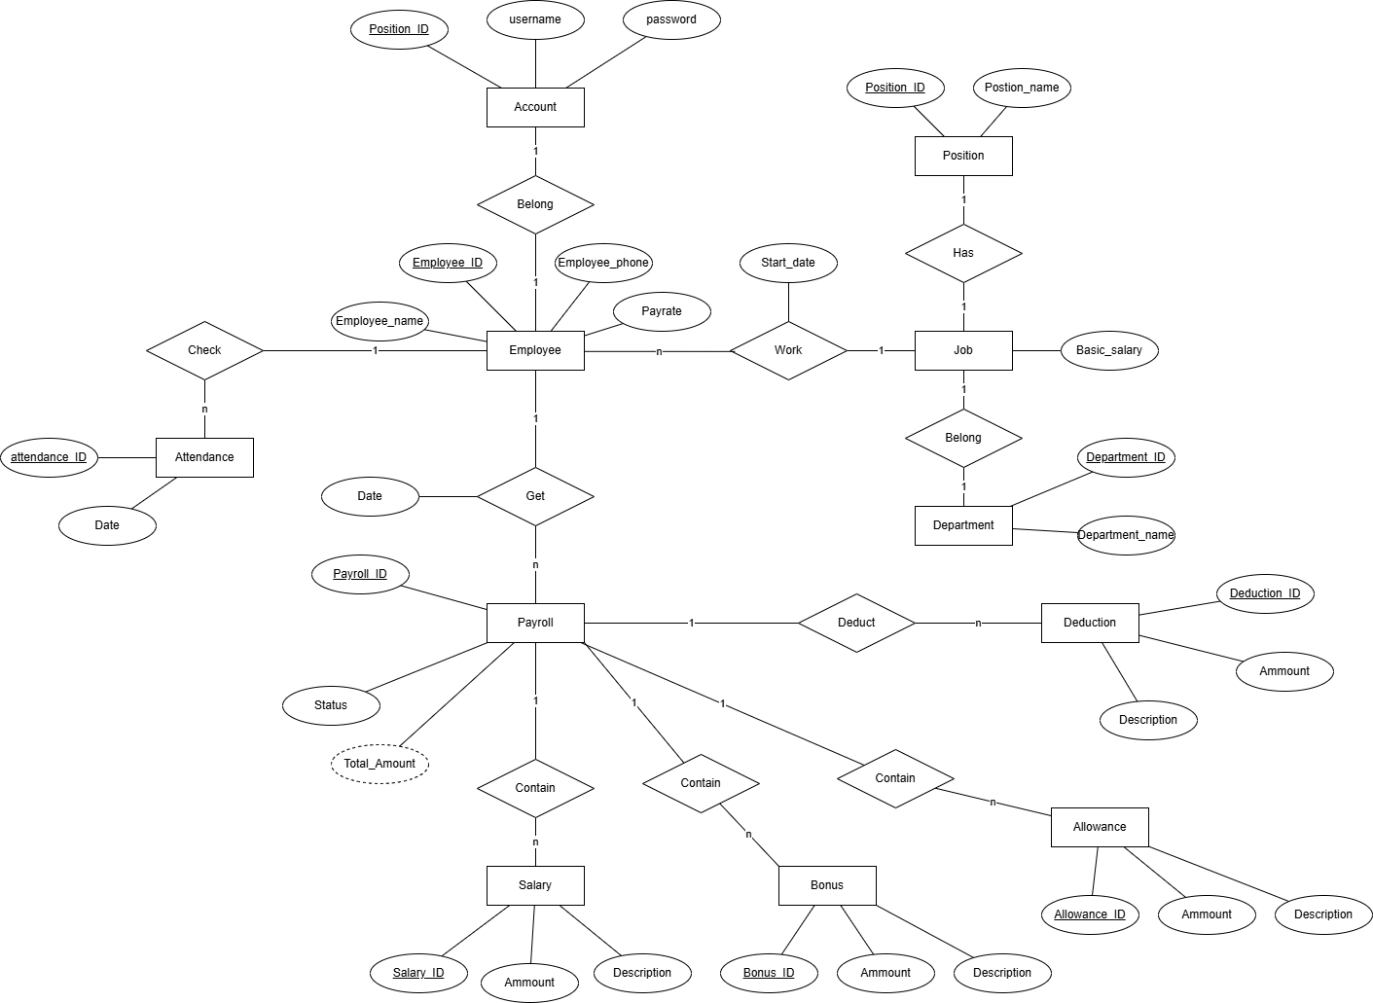

ERD

Slide 8
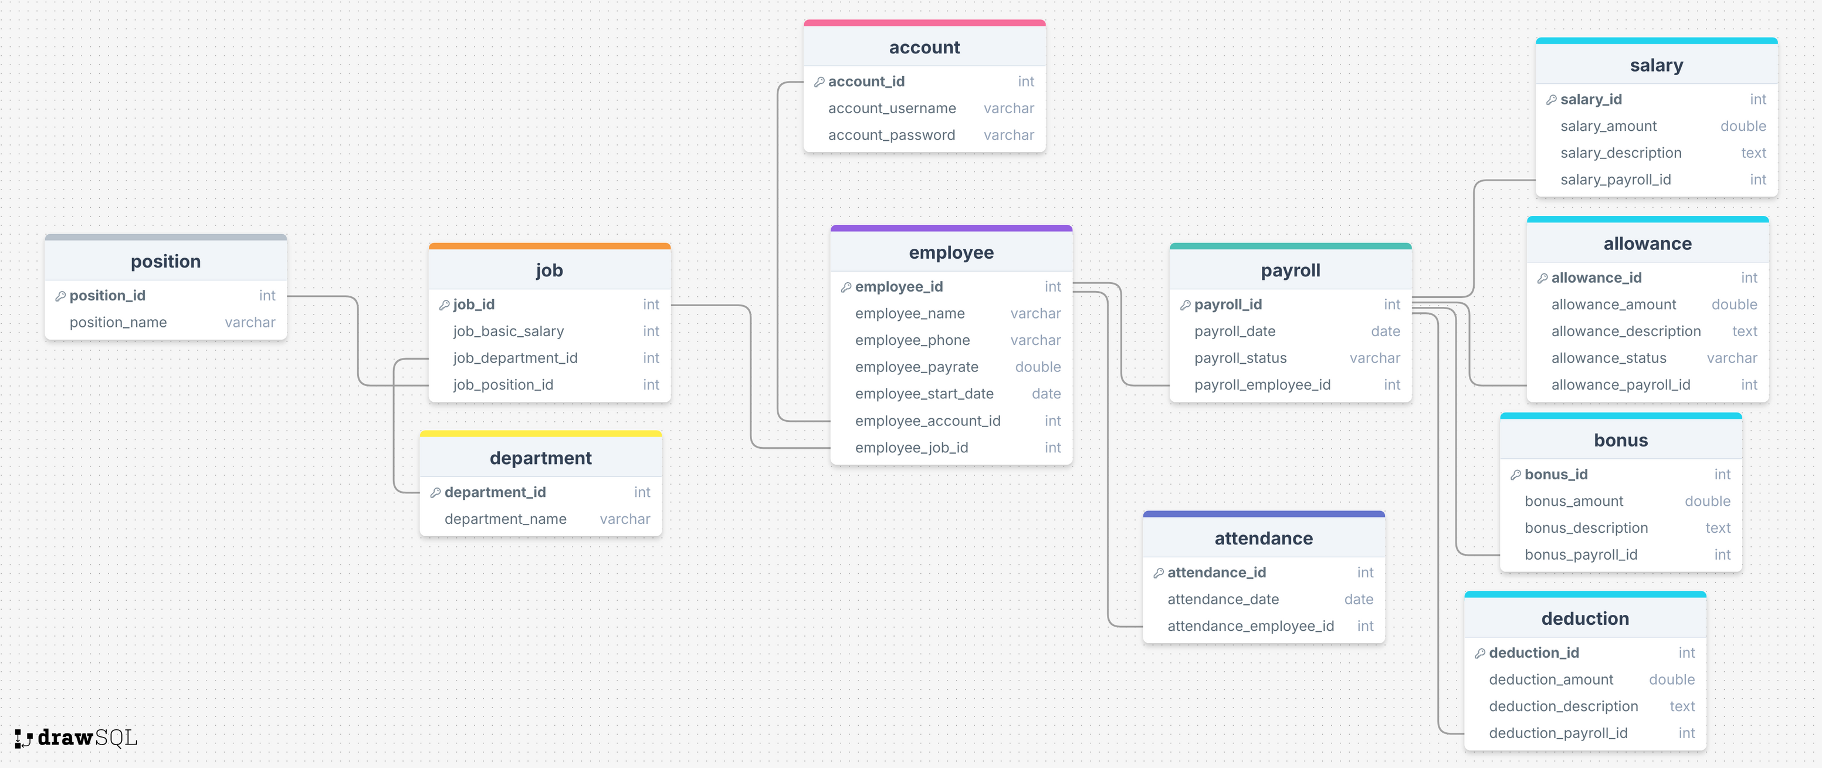
RELATIONAL SCHEMA

Slide 9
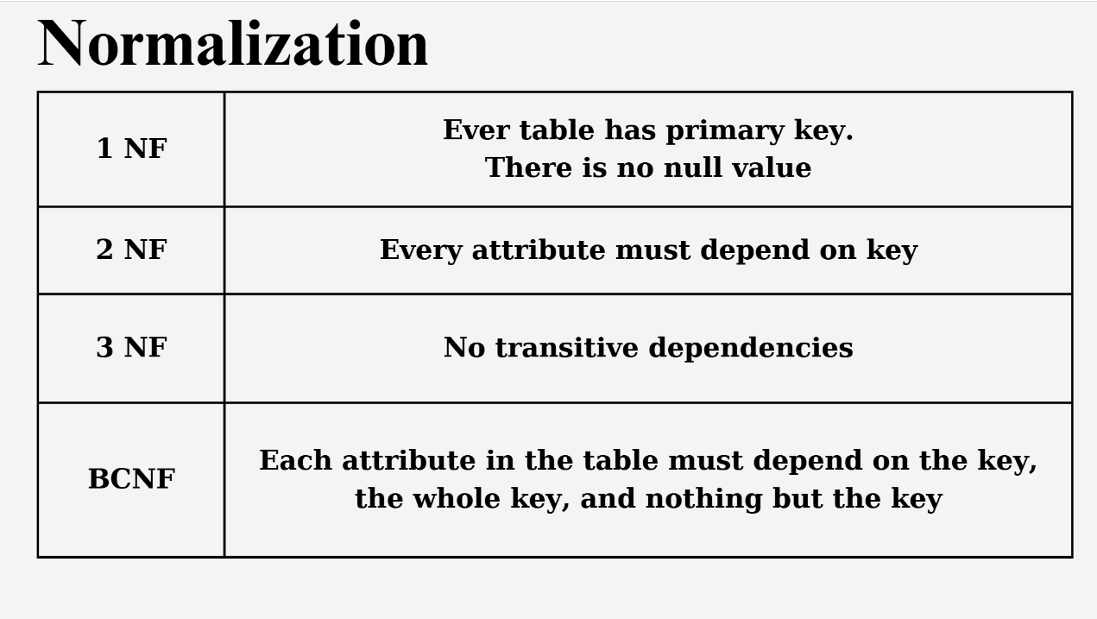

Slide 10
Login information

Slide 11
Employee Information

Slide 12
Payroll Information

Slide 13
SETUP

Slide 14


Slide 15

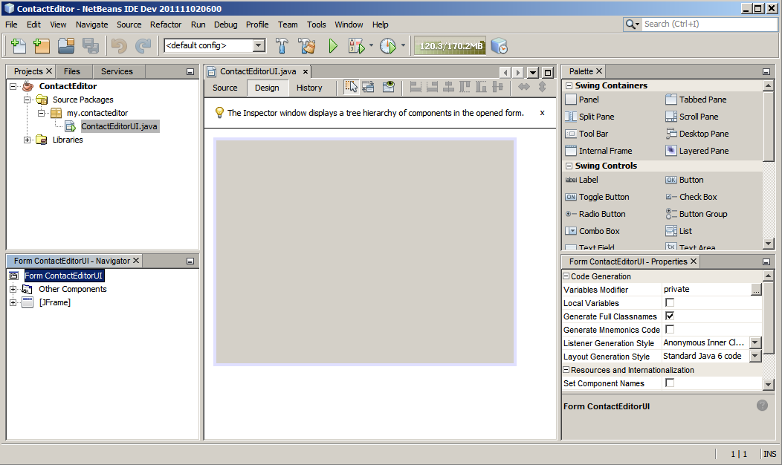
Netbeans IDE
Powerful Swing GUI Design

Slide 16


Slide 17
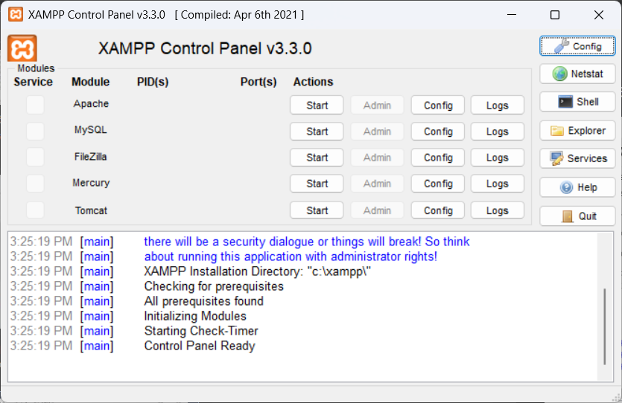

Slide 18
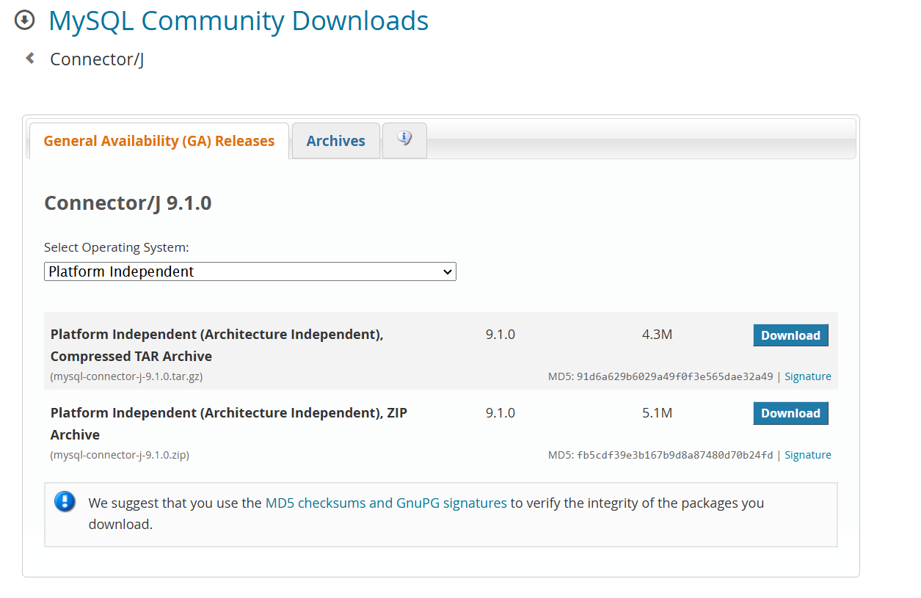
MySQL JDBC
https://dev.mysql.com/downloads/connector/j/

Slide 19
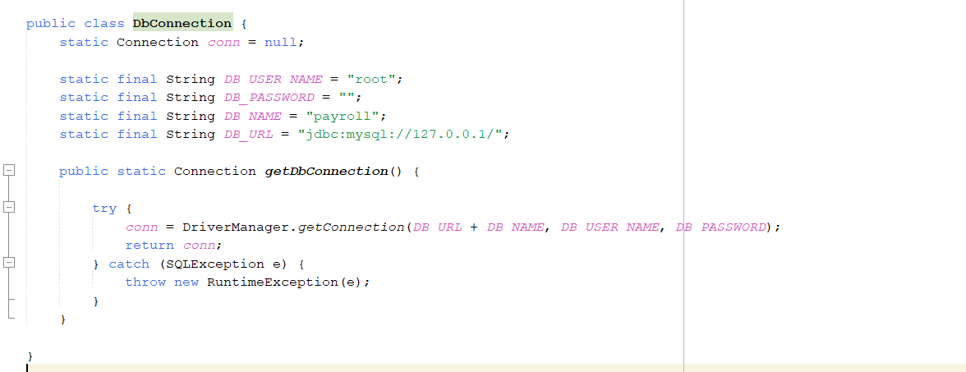
DbConnection

Slide 20
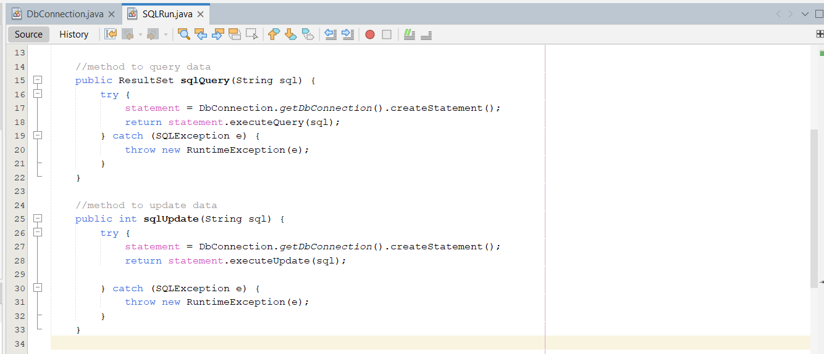
sqlQuery: Give back a ResultSet (SELECT)
sqlUpdate: Execute query.

Slide 21
IMPLEMENTATION

Slide 22
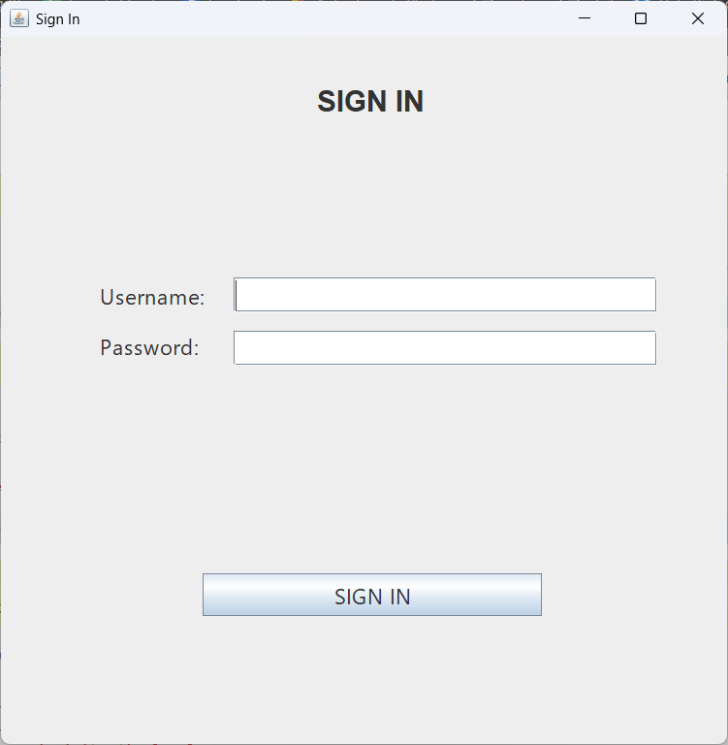

Slide 23
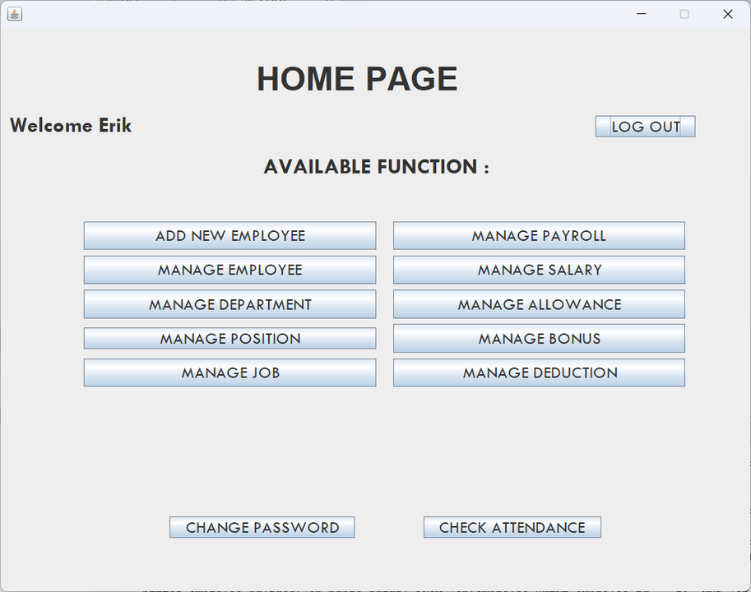
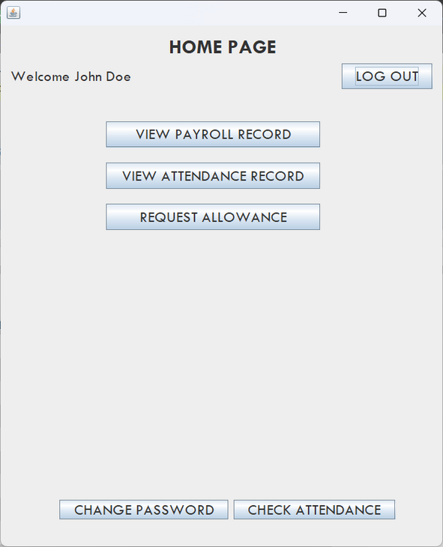
Two home page
HR home page
Default home page

Slide 24
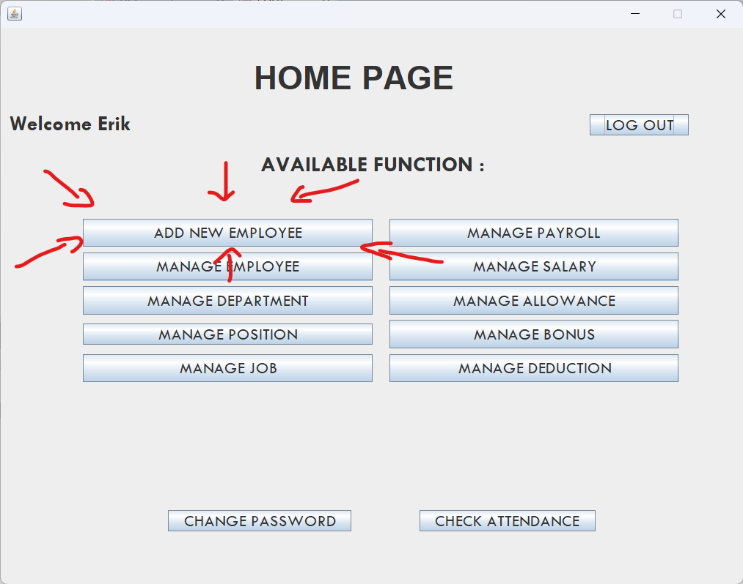
Create new account

Slide 25
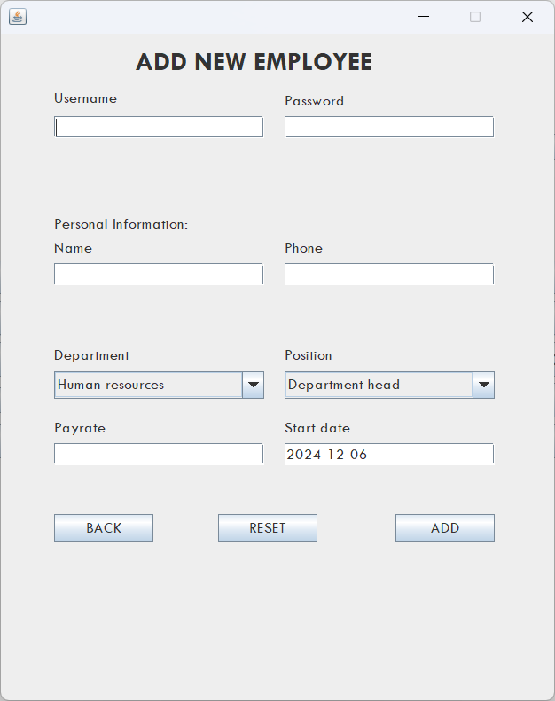
Create new account

Slide 26
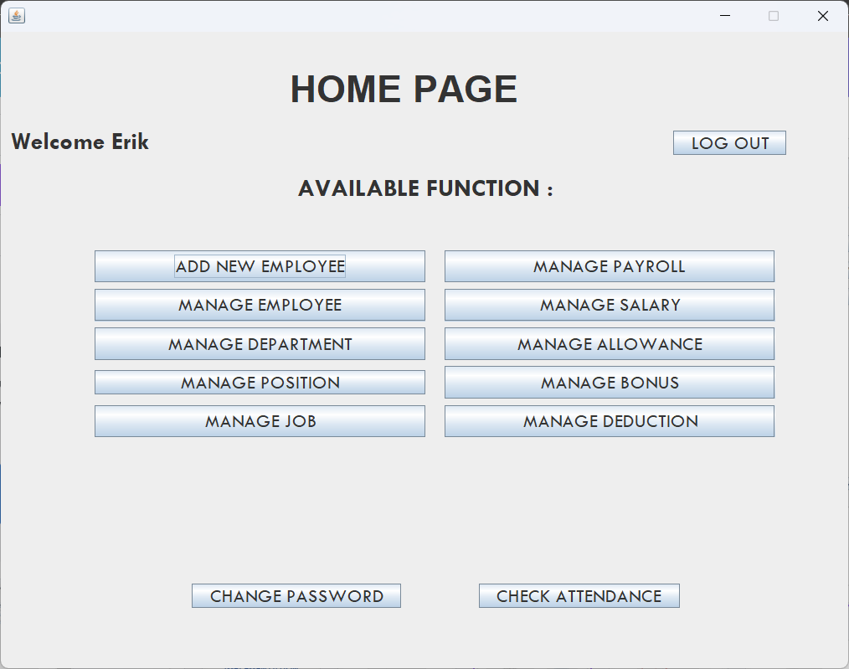
HR can manage all information

Slide 27
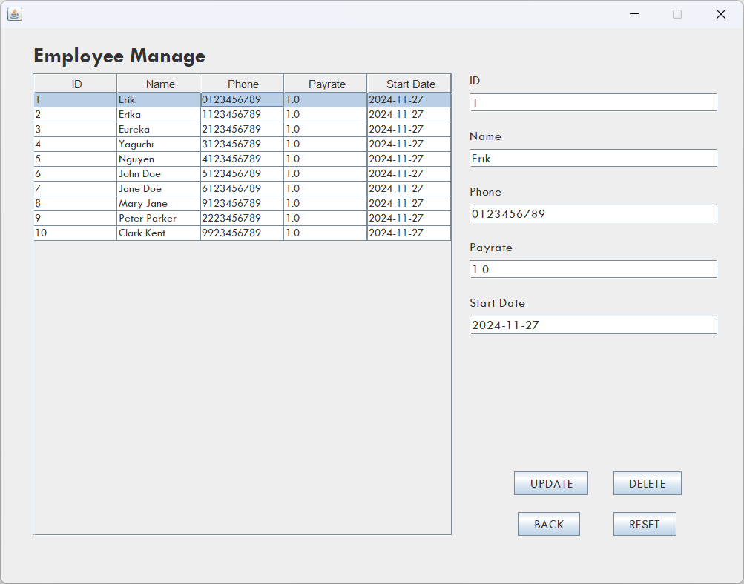
Example. Manage Employee

Slide 28
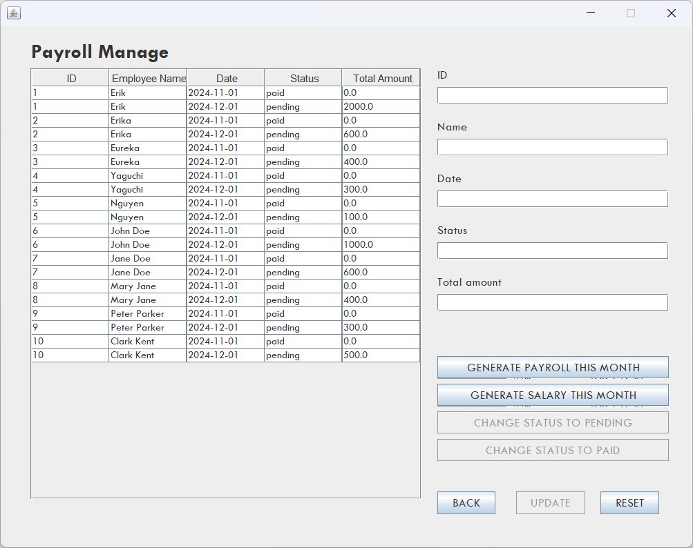
Example. Manage Payroll

Slide 29
CONCLUSION

Slide 30
Objectives
Manage Employee Information
Checking attendance
Calculating Salary

Slide 31


Problems
Hard to use
Security flaws
HR employee can leak information
Delete important data by mistake

Slide 32

Future works
Enhance security
Implement online database
Add more features to defaults users

Slide 33
References
https://netbeans.apache.org/front/main/index.html
https://dev.mysql.com/doc/
Lecture slides from PDM course

